Slide 1

CSE 412: Artificial Intelligence
Topic – 5: Game Playing
Department of CSE
Daffodil International University

Slide 2


Topic Contents
Case Studies: Playing Grandmaster Chess
Game Playing as Search
Optimal Decisions in Games
    Greedy search algorithm
    Minimax algorithm
Alpha-Beta Pruning

Slide 3
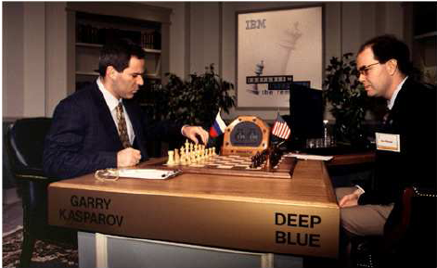
Case Studies: Playing Grandmaster Chess
The real success of AI in game-playing was achieved much later after many years’ effort.
It has been shown that this search based approach works extremely well.
In 1996 IBM Deep Blue beat Gary Kasparov for the first time. and in 1997 an upgraded version won an entire match against the same opponent.

Slide 4
Case Studies: Playing Grandmaster Chess…
Kasparov vs. Deep Blue, May 1997
6 game full-regulation match sponsored by ACM
Kasparov lost the match 1 wins to 2 wins and 3 tie
This was a historic achievement for computer chess being the first time a computer became
the best chess player on the planet.
Note that Deep Blue plays by “brute force” (i.e. raw power from computer speed and memory). It uses relatively little that is similar to human intuition and cleverness.

Slide 5
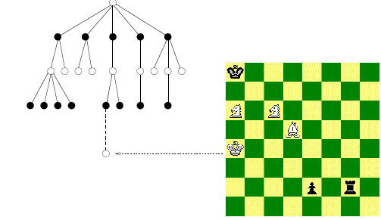
Game Playing and AI
Why would game playing be a good problem for AI research?
  game playing is non-trivial
    players need “human-like” intelligence
    games can be very complex (e.g. chess, go)
    requires decision making within limited time
  game playing can be usefully viewed as a search problem in a space defined by a fixed set of rules
    Nodes are either white or black corresponding to reflect the adversaries’ turns.
    The tree of possible moves can be searched for favourable positions.

Slide 6
Game Playing and AI…
Why would game playing be a good problem for AI research?
  games often are:
    well-defined and repeatable
    easy to represent
    fully observable and limited environments
  can directly compare humans and computers

Slide 7
Game Playing as Search
Consider two-player, turn-taking, board games
  e.g., tic-tac-toe, checkers, chess
Representing these as search problem:
  states: board configurations
  edges: legal moves
  initial state: start board configuration
  goal state: winning/terminal board configuration

Slide 8
Game Playing as Search:
Game Tree
What's the new aspect
to the search problem?
There’s an opponent
that we cannot control!
…
X
X
X
X
X
…
X
O
X
O
X
X
X
O
O
O
…
X
X
X
X
X
O
X
X
O
O
X
O
How can this be handled?

Slide 9
Game Playing as Search: Complexity
Assume the opponent’s moves can be
predicted given the computer's moves.
How complex would search be in this case?
  worst case: O(b^{d}) ; b is branching factor, d is depth
  Tic-Tac-Toe: ~5 legal moves, 9 moves max game
    5⁹ = 1,953,125 states
  Chess: ~35 legal moves, ~100 moves per game
    35¹⁰⁰ ~10¹⁵⁴ states, but only ~10⁴⁰ legal states
Common games produce enormous search trees.

Slide 10

Greedy Search Game Playing
A utility function maps each terminal state of the board to a numeric value corresponding to the value of that state to the computer.
  positive for winning, > + means better for computer
  negative for losing, > - means better for opponent
  zero for a draw
  typical values (lost to win):
    -infinity to +infinity
    -1.0 to +1.0

Slide 11
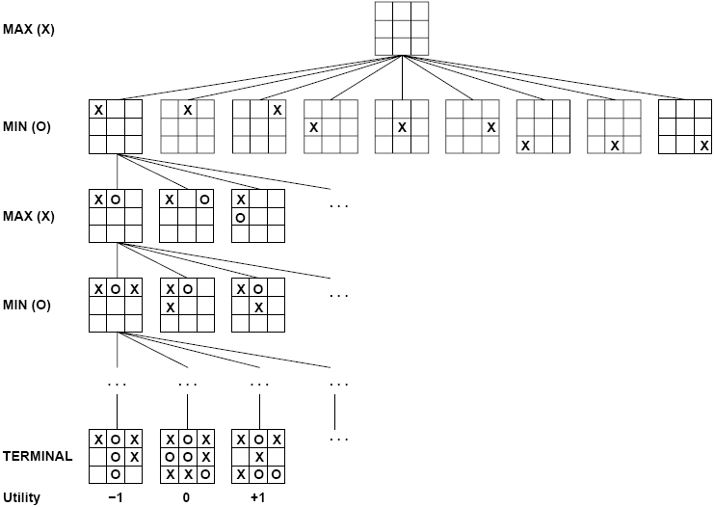


Slide 12
Greedy Search Game Playing
Expand each branch to the terminal states
Evaluate the utility of each terminal state
Choose the move that results in the board configuration with the maximum value
A
A
9
computer's
possible moves
B
B
-5
C
C
9
D
D
2
E
E
3
opponent's
possible moves
F
F
-7
G
G
-5
H
H
3
I
I
9
J
J
-6
K
K
0
L
L
2
M
M
1
N
N
3
O
O
2
board evaluation from computer's perspective
terminal states

Slide 13
Greedy Search Game Playing
Assuming a reasonable search space,
what's the problem with greedy search?
It ignores what the opponent might do!
e.g. Computer chooses C. Opponent chooses J and defeats computer.
A
9
computer's
possible moves
B
-5
C
9
D
2
E
3
opponent's
possible moves
F
-7
G
-5
H
3
I
9
J
-6
K
0
L
2
M
1
N
3
O
2
board evaluation from computer's perspective
terminal states

Slide 14
Minimax: Idea
Assuming the worst (i.e. opponent plays optimally):
  given there are two plays till the terminal states
  If high utility numbers favor the computer
    Computer should choose which moves?
    maximizing moves
  If low utility numbers favor the opponent
    Smart opponent chooses which moves?
    minimizing moves

Slide 15
Minimax: Idea
The computer assumes after it moves the opponent will choose the minimizing move.
It chooses its best move considering
both its move and opponent’s best move.
A
A
1
computer's
possible moves
B
B
-7
C
C
-6
D
D
0
E
E
1
opponent's
possible moves
F
-7
G
-5
H
3
I
9
J
-6
K
0
L
2
M
1
N
3
O
2
board evaluation from computer's perspective
terminal states

Slide 16
Minimax: Passing Values up Game Tree
Explore the game tree to the terminal states
Evaluate the utility of the terminal states
Computer chooses the move to put the board
in the best configuration for it assuming
the opponent makes best moves on her turns:
  start at the leaves
  assign value to the parent node as follows
    use minimum of children when opponent’s moves
    use maximum of children when computer's moves

Slide 17
Deeper Game Trees
Minimax can be generalized for > 2 moves
Values backed up in minimax way
A
A
3
computer max
B
B
-5
C
C
3
D
0
E
E
-7
opponent
min
F
F
4
G
-5
H
3
I
8
J
J
9
K
K
5
L
2
M
M
-7
computer
max
N
4
O
O
-5
P
9
Q
-6
R
0
S
3
T
5
U
-7
V
-9
opponent
min
W
-3
X
-5
terminal states

Slide 18
Minimax: Direct Algorithm
For each move by the computer:
Perform depth-first search to a terminal state
Evaluate each terminal state
Propagate upwards the minimax values
  if opponent's move minimum value of children backed up
  if computer's move maximum value of children backed up
choose move with the maximum of minimax values of children
Note:
minimax values gradually propagate upwards as DFS proceeds: i.e., minimax values propagate up
in “left-to-right” fashion
minimax values for sub-tree backed up “as we go”,
so only O(bd) nodes need to be kept in memory at any time

Slide 19
Minimax: Algorithm Complexity
Assume all terminal states are at depth d
Space complexity?
depth-first search, so O(bd)
Time complexity?
given branching factor b, so O(b^{d})
Time complexity is a major problem!
Computer typically only has a
finite amount of time to make a move.

Slide 20
Minimax: Algorithm Complexity
Direct minimax algorithm is impractical in practice
  instead do depth-limited search to ply (depth) m
What’s the problem for stopping at any ply?
  evaluation defined only for terminal states
  we need to know the value of non-terminal states
Static board evaluator (SBE) function uses heuristics to estimate the value of non-terminal states.
It was first proposed by Shannon in his paper, Programming a computer for playing chess, in 1950.

Slide 21
Minimax:
Static Board Evaluator (SBE)
When using the Minimax algorithm, the AI needs to evaluate game states. However, in complex games like chess or Go, it is impractical to search all the way to the end. Instead, we use a Static Board Evaluator (SBE) to estimate the quality of a position when the search must stop early..

Slide 22
Minimax:
Static Board Evaluator (SBE)
Goal: Assign a numeric value to a game state based on how favorable it is for the AI.
Positive score: Good for AI.
Negative score: Good for opponent.
Zero: Neutral state.

Slide 23
Minimax:
Static Board Evaluator (SBE)
A static board evaluation function estimates how good a board configuration is for the computer.
  it reflects the computer’s chances of winning from that state
  it must be easy to calculate from the board configuration
For Example, Chess:
SBE = α * materialBalance + β * centerControl + γ * …
material balance = Value of white pieces - Value of black pieces
(pawn = 1, rook = 5, queen = 9, etc).

Slide 24
Minimax:
Static Board Evaluator (SBE)
How to design good static board evaluator functions?
First, the evaluation function should order the terminal states in the same way as the true utility function; otherwise, an agent using it might select suboptimal moves even if it can see ahead all the way to the end of the game.
Second, the computation must not take too long!
Third, for nonterminal states, the evaluation function should be strongly correlated with the actual chances of winning.

Slide 25
Minimax:
Static Board Evaluator (SBE)
First, Order Terminal States Correctly
The evaluation function should assign values that match the true game outcome.
If a state is a win, it must get the highest possible score.
If a state is a loss, it must get the lowest possible score.
If a state is a draw, it should get a neutral score (0 or equivalent).

Slide 26
Minimax:
Static Board Evaluator (SBE)
Why?
If terminal states are not ranked correctly, the AI might misjudge which moves lead to wins or losses.
Example (Chess)
  Win for AI → Assign +1000
  Loss for AI → Assign -1000
  Draw → Assign 0
Bad SBE example
  If a losing position is given a higher value than a winning position, the AI may choose losing moves thinking they are better.

Slide 27
Minimax:
Static Board Evaluator (SBE)
Second, Must be Computed Quickly
The function should be efficient and fast.
Games like Chess and Go have millions of possible positions.
If the function is too slow, AI will take too long to make a move.

Slide 28
Minimax:
Static Board Evaluator (SBE)
Why?
AI needs to evaluate many board positions per second to make real-time decisions.
Solution:
Use lightweight heuristics instead of brute-force calculations.
Example (Chess SBE - Simple Material Count):
SBE=(Sum of AI’s piece values)−(Sum of opponent’s piece values)
Pawn = 1, Knight = 3, Bishop = 3, Rook = 5, Queen = 9.
Faster to compute than analyzing all possible future moves.

Slide 29
Minimax:
Static Board Evaluator (SBE)
Third, Strong Correlation with Winning Chances
The function should accurately predict which positions are strong and which are weak.
Even if a game is far from ending, SBE should estimate the likelihood of winning.

Slide 30
Minimax:
Static Board Evaluator (SBE)
Why?
If the function is inaccurate, AI may overvalue weak positions or undervalue winning moves.
Example (Tic-Tac-Toe SBE - Open Winning Lines):
  SBE=(Winning lines open for AI)−(Winning lines open for opponent)
  If AI has 2 Xs in a row and an empty space → Good position (positive score).
  If the opponent has 2 Os in a row and an empty space → Dangerous position (negative score).
Bad SBE example
  If AI only considers the number of pieces but ignores threats from the opponent, it may fail to block a winning move.

Slide 31
Minimax:
Static Board Evaluator (SBE)
Evaluation function is a heuristic function, and it is where the domain experts’ knowledge resides.
Example of an evaluation function for Tic-Tac-Toe:
  f(n) = [# of 3-lengths open for me] - [# of 3-lengths open for you],
  where a 3-length is a complete row, column, or diagonal.
Alan Turing’s function for chess
  f(n) = w(n)/b(n), where w(n) = sum of the point value of white’s pieces and b(n) is sum for black.
Most evaluation functions are specified as a weighted sum of position features:
  f(n) = w₁*feat1(n) + w₂*feat2(n) + ... + w_{n}*featk(n)
Example features for chess are piece count, piece placement, squares controlled, etc.
Deep Blue has about 6,000 features in its evaluation function.

Slide 32
Minimax: Algorithm with SBE
int minimax (Node s, int depth, int limit) {
if (isTerminal(s) || depth == limit) //base case
return(staticEvaluation(s));
else {
Vector v = new Vector();
//do minimax on successors of s and save their values
while (s.hasMoreSuccessors())
v.addElement(minimax(s.getNextSuccessor(),
depth+1, limit));
if (isComputersTurn(s))
return maxOf(v); //computer's move returns max of kids
else
return minOf(v); //opponent's move returns min of kids
}
}

Slide 33
Minimax: Algorithm with SBE
The same as direct minimax, except
  only goes to depth m
  estimates non-terminal states using SBE function
How would this algorithm perform at chess?
  if could look ahead ~4 pairs of moves (i.e. 8 ply)
  would be consistently beaten by average players
  if could look ahead ~8 pairs as done in typical pc, is as good as human master

Slide 34
Recap
Can't minimax search to the end of the game.
  if could, then choosing move is easy
SBE isn't perfect at estimating.
  if it was, just choose best move without searching

Slide 35
Alpha-Beta Pruning Idea
Some of the branches of the game tree won't be taken if playing against a smart opponent.
Use pruning to ignore those branches.
While doing DFS of game tree, keep track of:
  alpha at maximizing levels (computer’s move)
    highest SBE value seen so far (initialize to -infinity)
    is lower bound on state's evaluation
  beta at minimizing levels (opponent’s move)
    lowest SBE value seen so far (initialize to +infinity)
    is higher bound on state's evaluation

Slide 36
Alpha-Beta Pruning Idea
Beta cutoff pruning occurs when maximizing
if child’s alpha ≥ parent's beta
Why stop expanding children?
  opponent won't allow computer to take this move
Alpha cutoff pruning occurs when minimizing
if parent's alpha ≥ child’s beta
Why stop expanding children?
  computer has a better move than this

Slide 37
Alpha-Beta Search Example
minimax(A,0,4)
alpha initialized to -infinity
Expand A? Yes since there are successors, no cutoff test for root
A
Call
Stack
A
max
A
α=-
B
C
D
0
E
F
G
-5
H
3
I
8
J
K
L
2
M
N
4
O
P
9
Q
-6
R
0
S
3
T
5
U
-7
V
-9
W
-3
X
-5
A

Slide 38
Alpha-Beta Search Example
minimax(B,1,4)
beta initialized to +infinity
Expand B? Yes since A’s alpha >= B’s beta is false, no alpha cutoff
A
α=-
Call
Stack
max
B
B
B
β=+
C
D
0
E
min
F
G
-5
H
3
I
8
J
K
L
2
M
N
4
O
P
9
Q
-6
R
0
S
3
T
5
U
-7
V
-9
B
W
-3
X
-5
A

Slide 39
Alpha-Beta Search Example
minimax(F,2,4)
alpha initialized to -infinity
Expand F? Yes since F’s alpha >= B’s beta is false, no beta cutoff
A
α=-
Call
Stack
max
B
β=+
C
D
0
E
min
F
F
F
α=-
G
-5
H
3
I
8
J
K
L
2
M
max
N
4
O
P
9
Q
-6
R
0
S
3
T
5
U
-7
V
-9
F
B
W
-3
X
-5
A

Slide 40
Alpha-Beta Search Example
minimax(N,3,4)
evaluate and return SBE value
A
α=-
Call
Stack
max
B
β=+
C
D
0
E
min
F
α=-
G
-5
H
3
I
8
J
K
L
2
M
max
N
N
4
N
4
O
P
9
Q
-6
R
0
S
3
T
5
U
-7
V
-9
F
B
W
-3
X
-5
green: terminal state
A

Slide 41
Alpha-Beta Search Example
back to
minimax(F,2,4)
alpha = 4, since 4 >= -infinity (maximizing)
Keep expanding F? Yes since F’s alpha >= B’s beta is false, no beta cutoff
A
α=-
Call
Stack
max
B
β=+
C
D
0
E
min
F
α=-
F
α=4
G
-5
H
3
I
8
J
K
L
2
M
max
N
4
O
P
9
Q
-6
R
0
S
3
T
5
U
-7
V
-9
F
B
W
-3
X
-5
A
Notes:
4 maximum seen so far

Slide 42
Alpha-Beta Search Example
minimax(O,3,4)
beta initialized to +infinity
Expand O? Yes since F’s alpha >= O’s beta is false, no alpha cutoff
A
α=-
Call
Stack
max
B
β=+
C
D
0
E
min
F
α=4
G
-5
H
3
I
8
J
K
L
2
M
max
O
N
4
O
O
O
β=+
P
9
Q
-6
R
0
S
3
T
5
U
-7
V
-9
F
B
min
W
-3
X
-5
A

Slide 43
Alpha-Beta Search Example
minimax(W,4,4)
evaluate and return SBE value
A
α=-
Call
Stack
max
B
β=+
C
D
0
E
min
F
α=4
G
-5
H
3
I
8
J
K
L
2
M
W
max
O
N
4
O
β=+
P
9
Q
-6
R
0
S
3
T
5
U
-7
V
-9
F
B
min
W
-3
A
W
-3
X
-5
blue: non-terminal state (depth limit)

Slide 44
Alpha-Beta Search Example
back to
minimax(O,3,4)
beta = -3, since -3 <= +infinity (minimizing)
Keep expanding O?
No since F’s alpha >= O’s beta is true: alpha cutoff
A
α=-
Call
Stack
max
B
β=+
C
D
0
E
min
F
α=4
G
-5
H
3
I
8
J
K
L
2
M
max
O
N
4
O
β=+
O
β=-3
P
9
Q
-6
R
0
S
3
T
5
U
-7
V
-9
F
B
min
W
-3
X
-5
A
Notes:
-3 minimum seen so far

Slide 45
Alpha-Beta Search Example
Why?
Smart opponent will choose W or worse, thus O's upper bound is –3.
Computer already has better move at N.
A
α=-
Call
Stack
max
B
β=+
C
D
0
E
min
F
α=4
G
-5
H
3
I
8
J
K
L
2
M
max
O
N
4
O
β=-3
P
9
Q
-6
R
0
S
3
T
5
U
-7
V
-9
F
B
min
W
-3
X
-5
A
X
-5
red: pruned state

Slide 46
Alpha-Beta Search Example
back to
minimax(F,2,4)
alpha doesn’t change, since -3 < 4 (maximizing)
Keep expanding F? No since no more successors for F
A
α=-
Call
Stack
max
B
β=+
C
D
0
E
min
F
α=4
G
-5
H
3
I
8
J
K
L
2
M
max
N
4
O
β=-3
P
9
Q
-6
R
0
S
3
T
5
U
-7
V
-9
F
B
min
W
-3
X
-5
A
X
-5

Slide 47
Alpha-Beta Search Example
back to
minimax(B,1,4)
beta = 4, since 4 <= +infinity (minimizing)
Keep expanding B?
Yes since A’s alpha >= B’s beta is false, no alpha cutoff
A
α=-
Call
Stack
max
B
β=+
B
β=4
C
D
0
E
min
F
α=4
G
-5
H
3
I
8
J
K
L
2
M
max
N
4
O
β=-3
P
9
Q
-6
R
0
S
3
T
5
U
-7
V
-9
B
min
W
-3
X
-5
A
X
-5

Slide 48
Alpha-Beta Search Example
minimax(G,2,4)
evaluate and return SBE value
A
α=-
Call
Stack
max
B
β=4
C
D
0
E
min
F
α=4
G
-5
G
-5
H
3
I
8
J
K
L
2
M
max
N
4
O
β=-3
P
9
Q
-6
R
0
S
3
T
5
U
-7
V
-9
G
B
min
W
-3
X
-5
A
X
-5
green: terminal state

Slide 49
Alpha-Beta Search Example
back to
minimax(B,1,4)
beta = -5, since -5 <= 4 (minimizing)
Keep expanding B? No since no more successors for B
A
α=-
Call
Stack
max
B
β=4
B
β=-5
C
D
0
E
min
F
α=4
G
-5
H
3
I
8
J
K
L
2
M
max
N
4
O
β=-3
P
9
Q
-6
R
0
S
3
T
5
U
-7
V
-9
B
min
W
-3
X
-5
A
X
-5
Notes:
-5 minimum seen so far

Slide 50
Alpha-Beta Search Example
back to
minimax(A,0,4)
alpha = -5, since -5 >= -infinity (maximizing)
Keep expanding A? Yes since there are more successors, no cutoff test
A
α=
Call
Stack
max
A
α=-5
B
β=-5
C
D
0
E
min
F
α=4
G
-5
H
3
I
8
J
K
L
2
M
max
N
4
O
β=-3
P
9
Q
-6
R
0
S
3
T
5
U
-7
V
-9
min
W
-3
X
-5
A
X
-5
Notes:
-5 maximum seen so far

Slide 51
Alpha-Beta Search Example
minimax(C,1,4)
beta initialized to +infinity
Expand C? Yes since A’s alpha >= C’s beta is false, no alpha cutoff
A
α=
Call
Stack
max
A
α=-5
B
β=-5
C
C
C
β=+
D
0
E
min
F
α=4
G
-5
H
3
I
8
J
K
L
2
M
max
N
4
O
β=-3
P
9
Q
-6
R
0
S
3
T
5
U
-7
V
-9
C
min
W
-3
X
-5
A
X
-5

Slide 52
Alpha-Beta Search Example
minimax(H,2,4)
evaluate and return SBE value
A
α=
Call
Stack
max
A
α=-5
B
β=-5
C
β=+
D
0
E
min
F
α=4
G
-5
H
3
H
3
I
8
J
K
L
2
M
max
N
4
O
β=-3
P
9
Q
-6
R
0
S
3
T
5
U
-7
V
-9
H
C
min
W
-3
X
-5
A
X
-5
green: terminal state

Slide 53
Alpha-Beta Search Example
back to
minimax(C,1,4)
beta = 3, since 3 <= +infinity (minimizing)
Keep expanding C? Yes since A’s alpha >= C’s beta is false, no alpha cutoff
A
α=
Call
Stack
max
A
α=-5
B
β=-5
C
β=+
C
β=3
D
0
E
min
F
α=4
G
-5
H
3
I
8
J
K
L
2
M
max
N
4
O
β=-3
P
9
Q
-6
R
0
S
3
T
5
U
-7
V
-9
C
min
W
-3
X
-5
A
X
-5

Slide 54
Alpha-Beta Search Example
minimax(I,2,4)
evaluate and return SBE value
A
α=
Call
Stack
max
A
α=-5
B
β=-5
C
β=3
D
0
E
min
F
α=4
G
-5
H
3
I
8
I
8
J
K
L
2
M
max
N
4
O
β=-3
P
9
Q
-6
R
0
S
3
T
5
U
-7
V
-9
I
C
min
W
-3
X
-5
A
X
-5
green: terminal state

Slide 55
Alpha-Beta Search Example
back to
minimax(C,1,4)
beta doesn’t change, since 8 > 3 (minimizing)
Keep expanding C? Yes since A’s alpha >= C’s beta is false, no alpha cutoff
A
α=
Call
Stack
max
A
α=-5
B
β=-5
C
β=3
D
0
E
min
F
α=4
G
-5
H
3
I
8
J
K
L
2
M
max
N
4
O
β=-3
P
9
Q
-6
R
0
S
3
T
5
U
-7
V
-9
C
min
W
-3
X
-5
A
X
-5

Slide 56
Alpha-Beta Search Example
minimax(J,2,4)
alpha initialized to -infinity
Expand J? Yes since J’s alpha >= C’s beta is false, no beta cutoff
A
α=
Call
Stack
max
A
α=-5
B
β=-5
C
β=3
D
0
E
min
F
α=4
G
-5
H
3
I
8
J
J
J
α=-
K
L
2
M
max
N
4
O
β=-3
P
9
Q
-6
R
0
S
3
T
5
U
-7
V
-9
J
C
min
W
-3
X
-5
A
X
-5

Slide 57
Alpha-Beta Search Example
minimax(P,3,4)
evaluate and return SBE value
A
α=
Call
Stack
max
A
α=-5
B
β=-5
C
β=3
D
0
E
min
F
α=4
G
-5
H
3
I
8
J
α=-
K
L
2
M
max
P
N
4
O
β=-3
P
9
P
9
Q
-6
R
0
S
3
T
5
U
-7
V
-9
J
C
min
W
-3
X
-5
A
X
-5
green: terminal state

Slide 58
Alpha-Beta Search Example
back to
minimax(J,2,4)
alpha = 9, since 9 >= -infinity (maximizing)
Keep expanding J?
No since J’s alpha >= C’s beta is true: beta cutoff
A
α=
Call
Stack
max
A
α=-5
B
β=-5
C
β=3
D
0
E
min
F
α=4
G
-5
H
3
I
8
J
α=-
J
α=9
K
L
2
M
max
N
4
O
β=-3
P
9
Q
-6
Q
-6
R
0
R
0
S
3
T
5
U
-7
V
-9
J
C
min
W
-3
X
-5
A
X
-5
red: pruned states

Slide 59
Alpha-Beta Search Example
Why?
Computer will choose P or better, thus J's lower bound is 9.
Smart opponent won’t let computer take move to J
(since opponent already has better move at H).
A
α=
Call
Stack
max
A
α=-5
B
β=-5
C
β=3
D
0
E
min
F
α=4
G
-5
H
3
I
8
J
α=9
K
L
2
M
max
N
4
O
β=-3
P
9
Q
-6
R
0
S
3
T
5
U
-7
V
-9
J
C
min
W
-3
X
-5
A
X
-5
red: pruned states

Slide 60
Alpha-Beta Search Example
back to
minimax(C,1,4)
beta doesn’t change, since 9 > 3 (minimizing)
Keep expanding C? No since no more successors for C
A
α=
Call
Stack
max
A
α=-5
B
β=-5
C
β=3
D
0
E
min
F
α=4
G
-5
H
3
I
8
J
α=9
K
L
2
M
max
N
4
O
β=-3
P
9
Q
-6
R
0
S
3
T
5
U
-7
V
-9
C
min
W
-3
X
-5
A
X
-5

Slide 61
Alpha-Beta Search Example
back to
minimax(A,0,4)
alpha = 3, since 3 >= -5 (maximizing)
Keep expanding A? Yes since there are more successors, no cutoff test
A
α=-5
Call
Stack
max
A
α=3
B
β=-5
C
β=3
D
0
E
min
F
α=4
G
-5
H
3
I
8
J
α=9
K
L
2
M
max
N
4
O
β=-3
P
9
Q
-6
R
0
S
3
T
5
U
-7
V
-9
min
W
-3
X
-5
A
X
-5

Slide 62
Alpha-Beta Search Example
minimax(D,1,4)
evaluate and return SBE value
A
α=
Call
Stack
max
A
α=3
B
β=-5
C
β=3
D
0
D
0
E
min
F
α=4
G
-5
H
3
I
8
J
α=9
K
L
2
M
max
N
4
O
β=-3
P
9
Q
-6
R
0
S
3
T
5
U
-7
V
-9
D
min
W
-3
X
-5
A
X
-5
green: terminal state

Slide 63
Alpha-Beta Search Example
back to
minimax(A,0,4)
alpha doesn’t change, since 0 < 3 (maximizing)
Keep expanding A? Yes since there are more successors, no cutoff test
A
α=
Call
Stack
max
A
α=3
B
β=-5
C
β=3
D
0
E
min
F
α=4
G
-5
H
3
I
8
J
α=9
K
L
2
M
max
N
4
O
β=-3
P
9
Q
-6
R
0
S
3
T
5
U
-7
V
-9
min
W
-3
X
-5
A
X
-5

Slide 64
Alpha-Beta Search Example
How does the algorithm finish searching the tree?
A
α=
Call
Stack
max
A
α=3
B
β=-5
C
β=3
D
0
E
min
F
α=4
G
-5
H
3
I
8
J
α=9
K
L
2
M
max
N
4
O
β=-3
P
9
Q
-6
R
0
S
3
T
5
U
-7
V
-9
min
W
-3
X
-5
A
X
-5

Slide 65
Alpha-Beta Search Example
Stop Expanding E since A's alpha >= E's beta is true: alpha cutoff
Why?
Smart opponent will choose L or worse, thus E's upper bound is 2.
Computer already has better move at C.
A
α=
Call
Stack
max
A
α=3
B
β=-5
C
β=3
D
0
E
β=2
min
F
α=4
G
-5
H
3
I
8
J
α=9
K
α=5
L
2
M
max
N
4
O
β=-3
P
9
Q
-6
R
0
S
3
T
5
U
-7
V
-9
min
W
-3
X
-5
A
X
-5

Slide 66
Alpha-Beta Search Example
Result: Computer chooses move to C.
A
α=
Call
Stack
max
A
α=3
B
β=-5
C
β=3
D
0
E
β=2
min
F
α=4
G
-5
H
3
I
8
J
α=9
K
α=5
L
2
M
max
N
4
O
β=-3
P
9
Q
-6
R
0
S
3
T
5
U
-7
V
-9
min
W
-3
X
-5
A
X
-5
green: terminal states, red: pruned states
blue: non-terminal state (depth limit)

Slide 67
Alpha-Beta Effectiveness
Effectiveness depends on the order
in which successors are examined.
What ordering gives more effective pruning?
  More effective if best successors are examined first.
Best Case: each player’s best move is left-most
Worst Case: ordered so that no pruning occurs
  no improvement over exhaustive search
In practice, performance is closer
to best case rather than worst case.

Slide 68
Alpha-Beta Effectiveness
If opponent’s best move where first
more pruning would result:
A
α=3
A
α=3
E
β=2
E
β=2
K
α=5
L
2
M
L
2
K
M
S
3
T
5
U
-7
V
-9
S
3
T
5
U
-7
V
-9

Slide 69
Alpha-Beta Effectiveness
In practice often get O(b^{(d/2)}) rather than O(b^{d})
  same as having a branching factor of sqrt(b)
  recall (sqrt(b))^{d} = b^{(d/2)}
For Example: chess
  goes from b ~ 35 to b ~ 6
  permits much deeper search for the same time
  makes computer chess competitive with humans

Slide 70
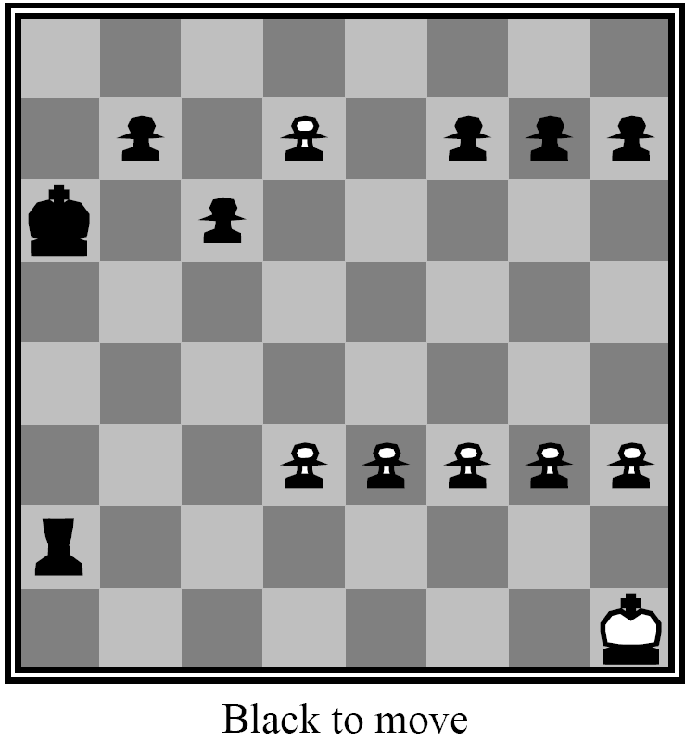

Slide 71
Other Issues: The Horizon Effect
Sometimes disaster lurks just
beyond search depth
  e.g. computer captures queen,
  but a few moves later the opponent checkmates
The computer has a limited horizon, it cannot
see that this significant event could happen
How do you avoid catastrophic losses
due to “short-sightedness”?
  quiescence search
  secondary search

Slide 72
Other Issues: The Horizon Effect
Quiescence Search
  when SBE value frequently changing,
  look deeper than limit
  looking for point when game quiets down
Secondary Search
  find best move looking to depth d
  look k steps beyond to verify that it still looks good
  if it doesn't, repeat step 2 for next best move

Slide 73

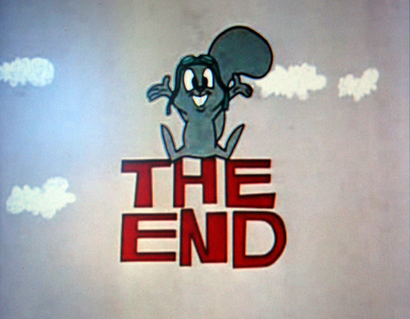
THANKS…

